Slide 1



Conservation decisions
Jeffrey Hanson
jeffrey.hanson@uqconnect.edu.au
jeffrey-hanson.com

Slide 2



Acknowledgements
Richard Fuller
Jonathan Rhodes
Cynthia Riginos
Hugh Possingham
Stuart Butchart
Graeme Buchanan
Carlo Rondinini
Francesco Ficetola
Silvia Carvalho
Ana Verissimo
Guillermo Velo-Anton
Adam Marques
Miguel Camo-Sanchez
Inigo Martinez Solano
Helena Goncalves
Fernando Sequira
Hugh Possingham
Richard Schuster
Matt Strimas-Mackey
Joe Bennett

Slide 3
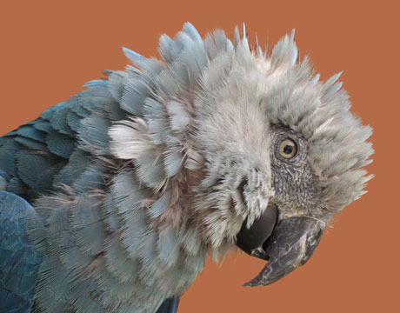
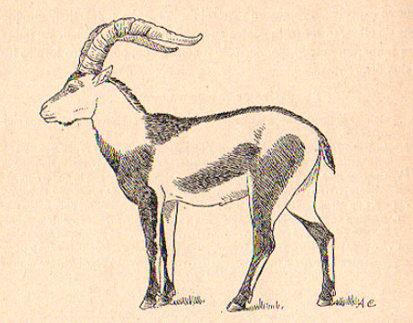
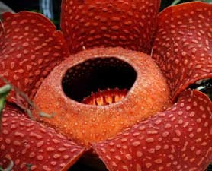
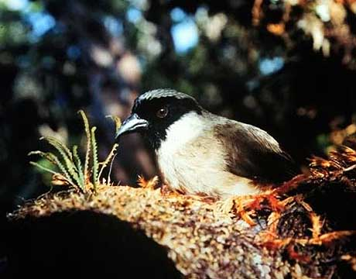
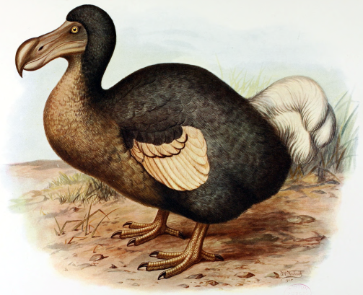
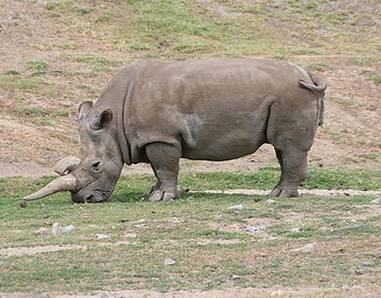
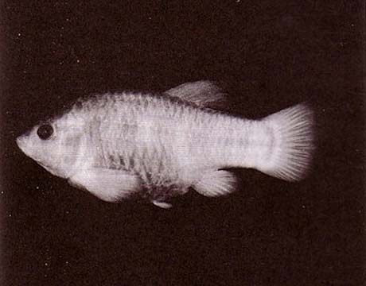
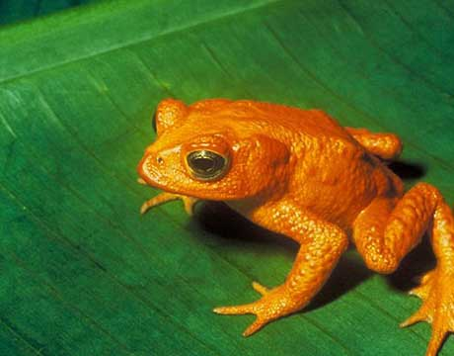
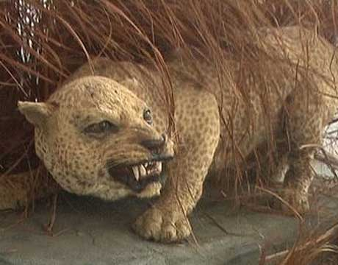
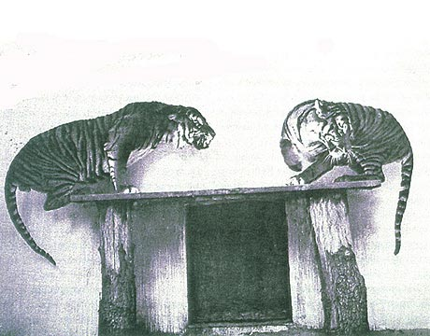
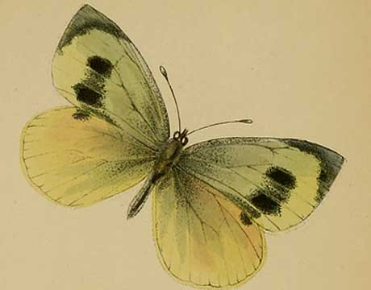
Global biodiversity crisis
Notes:
- high extinction rate
- conservation aims to maintain existing patterns of biodiversity and the processes that sustain them
- areas set aside to preserve biodiversity, and spearhead direct management actions

Slide 4
How to improve conservation decisions?
Better algorithms
Better quality data
Cost-effective surrogates for better data

Slide 5




Actions in places to achieve objectives
Establish reserves?
Remove pest species?
Restore habitat?
Captive breeding?
Restore habitat?
Monitor species?
Captive breeding
programmes?

Slide 6
Actions in places to achieve objectives
Establish protected areas
Biodiversity value
Different plans

Slide 7
Actions in places to achieve objectives
Establish protected areas
Biodiversity value
Different plans

Slide 8
Actions in places to achieve objectives
Establish protected areas
Biodiversity value
Different plans

Slide 9
Optimality in prioritizing conservation projects
Hanson et al. 2019 Methods Ecol. & Evol.

Slide 10
Project prioritization

Slide 11
Algorithms

Slide 12
New Zealand Native Birds

Slide 13
New Zealand Native Birds

Slide 16
Incorporating neutral genetic variation into conservation planning
Hanson et al. 2018 Methods Ecol. & Evol.

Slide 17
Conservation planning for adaptive and neutral evolutionary processes
Hanson et al. under review

Slide 18
Reserve selection
Notes:
- not all remaining habitat can be preserved
- achieve conservation objectives for minimal cost
- modern systematic conservation planning primarily focusses on representing species
- however, this ignores intra-specific biodiversity

Slide 19
Reserve selection

Slide 20
Reserve selection

Slide 21
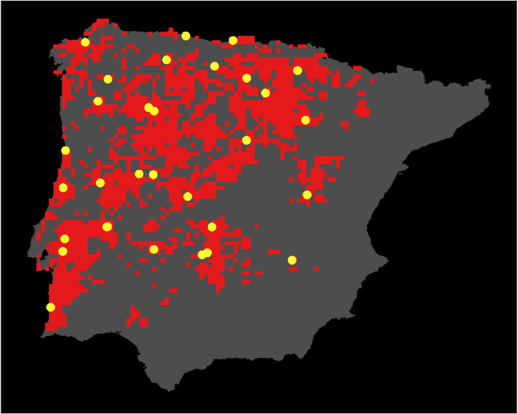
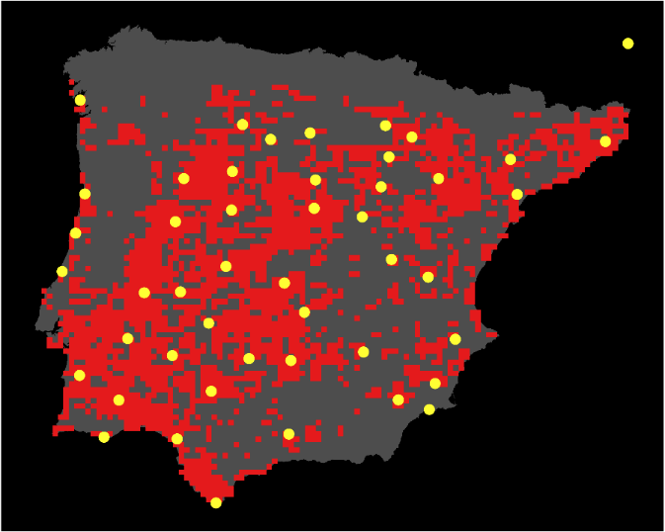
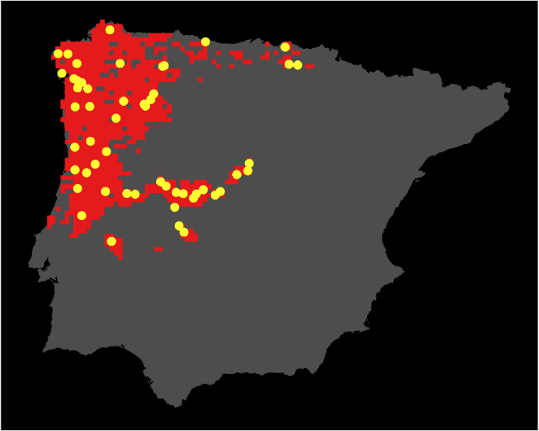

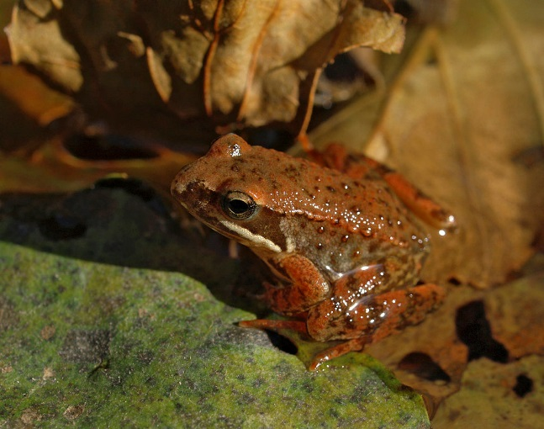
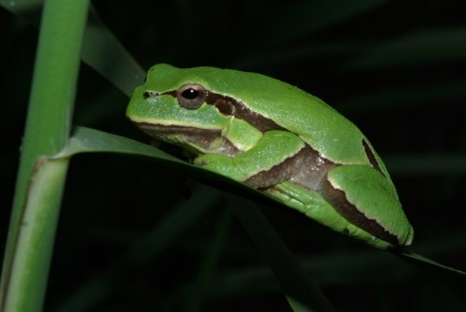
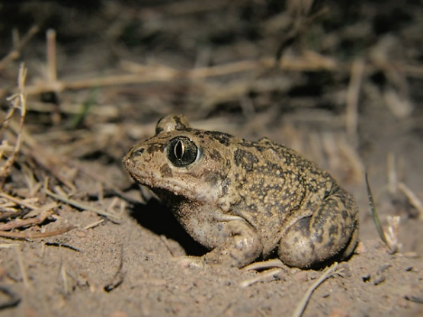

Case study
Hyla molleri
Pelobates cultripes
Rana iberica

Slide 22
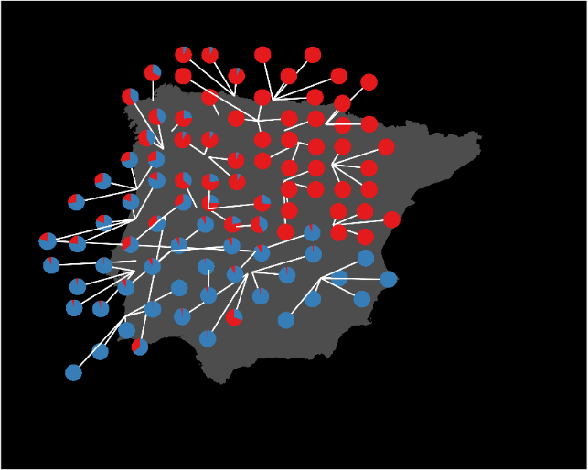
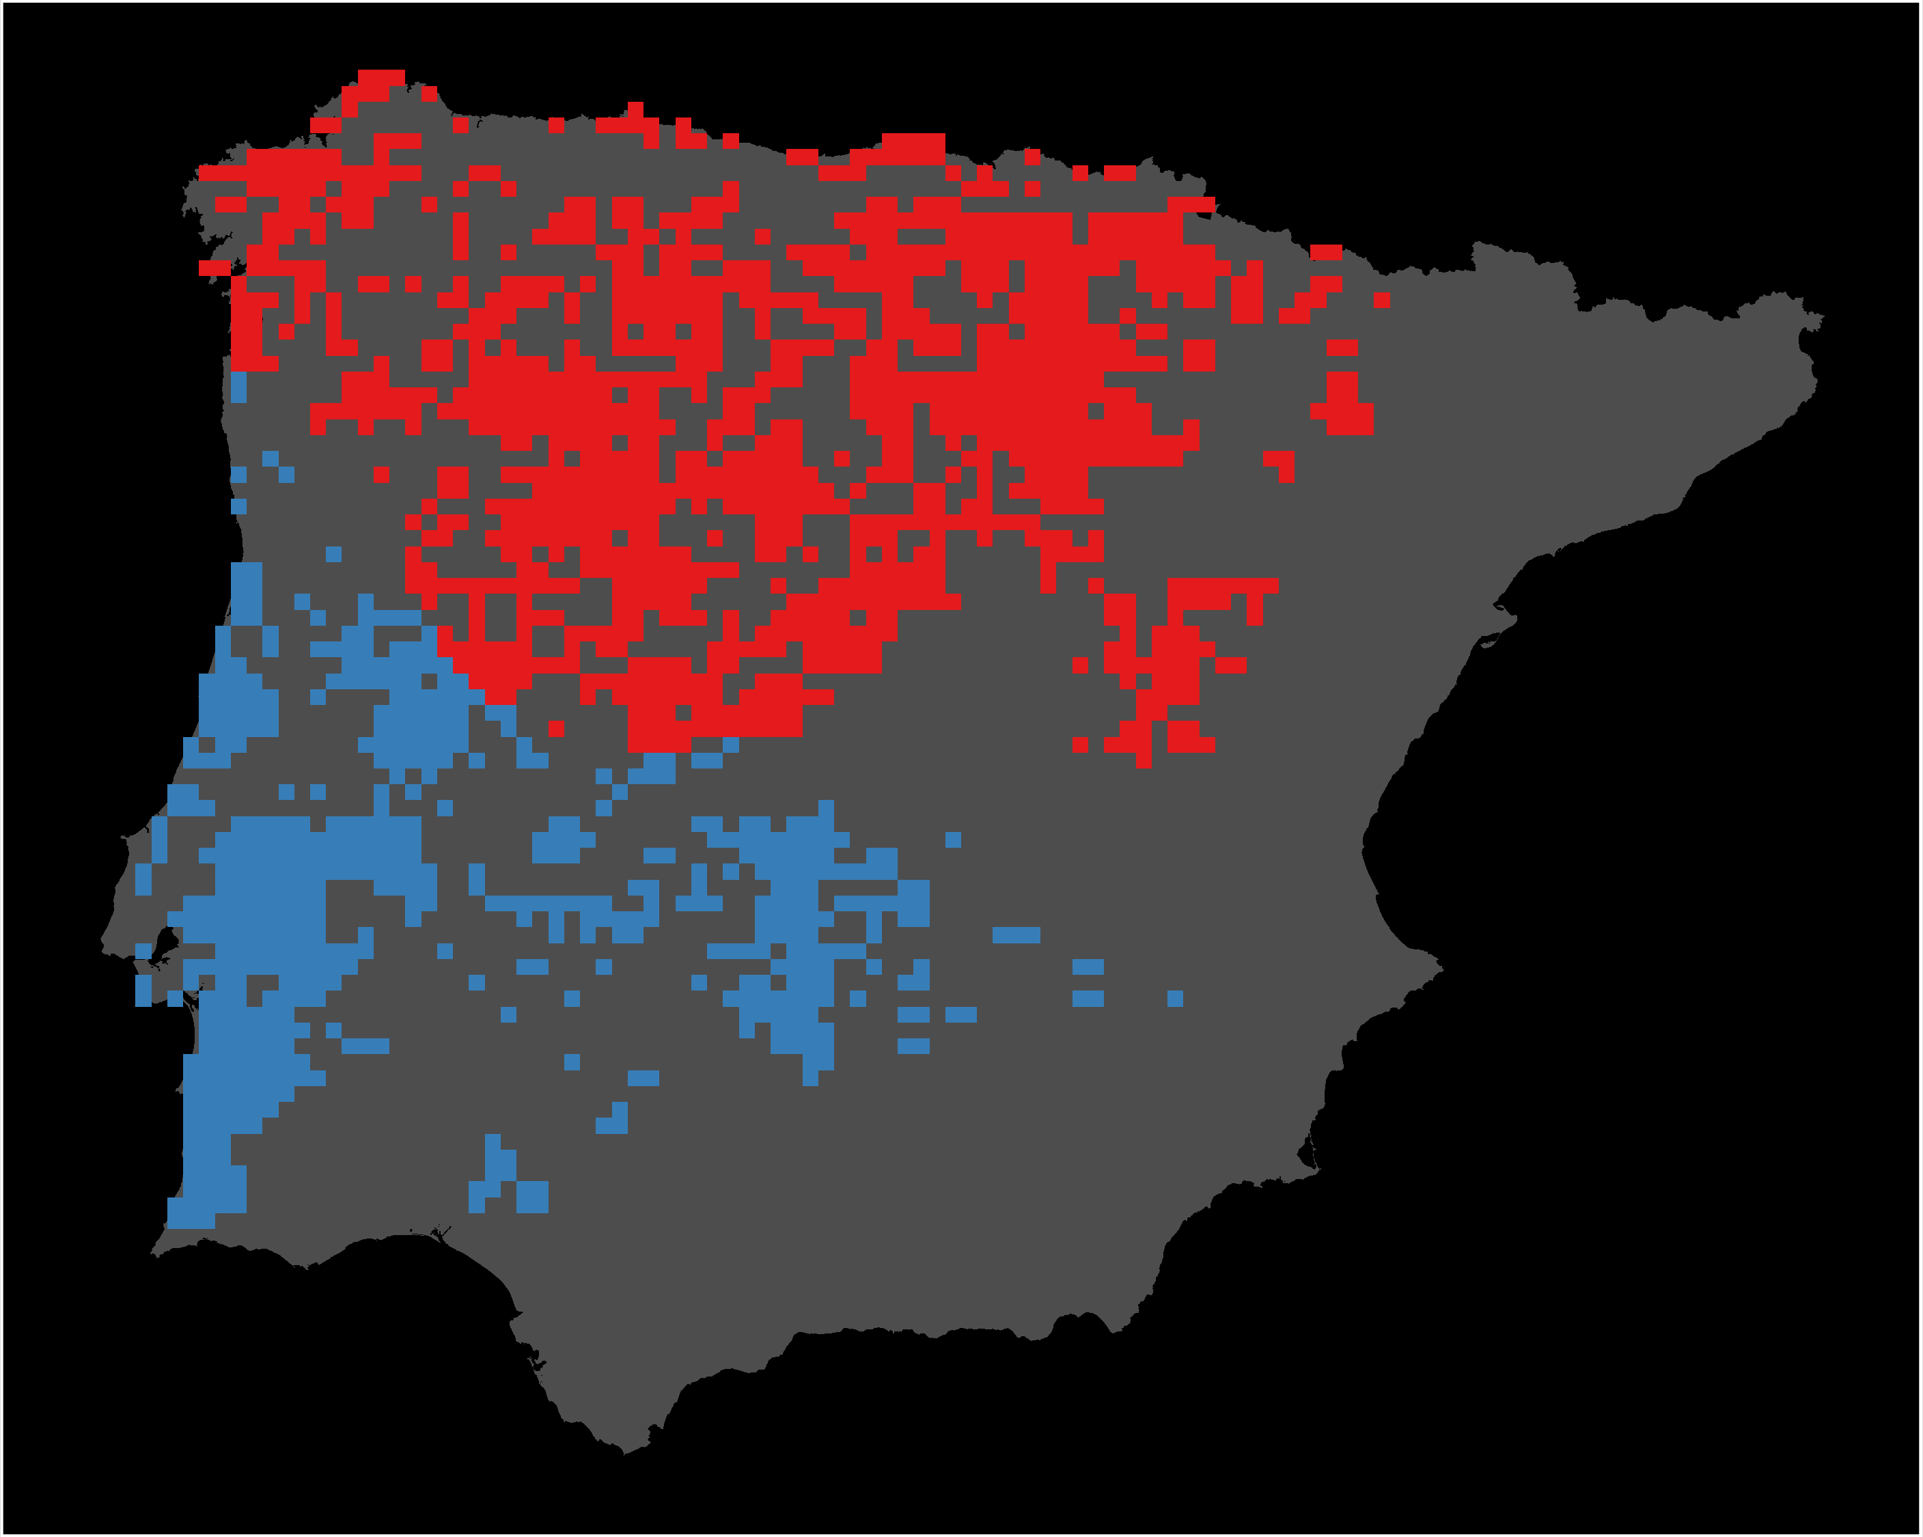

Mapping components of evolution: genetic lineages
STRUCTURE &
CLUMPP
PHYLIN
Genetic data
Data shown for Hyla molleri

Slide 23
Mapping components of evolution: identifying natural selection
Neutral
BAYESCAN
Genetic data
PCADAPT
Adaptive
Loci
SELESTIM

Slide 24
Evolutionary attributes
Individual heterozygosity

Slide 25
Evolutionary attributes
Individual heterozygosity

Slide 26
Evolutionary attributes
Neutral genetic clusters

Slide 27
Evolutionary attributes
Adaptive genetic clusters

Slide 28
Evolutionary attributes
Climatic refugia

Slide 34
Evolutionary processes
Species range
Population

Slide 35
Evolutionary processes
Species range
Population

Slide 36
Evolutionary processes
Species range
Population

Slide 37
Evolutionary processes
Species range
Population

Slide 38
Can we use environmental and geographic variables as surrogates for genetic variation in conservation planning?
Hanson et al. 2017 PNAS

Slide 39
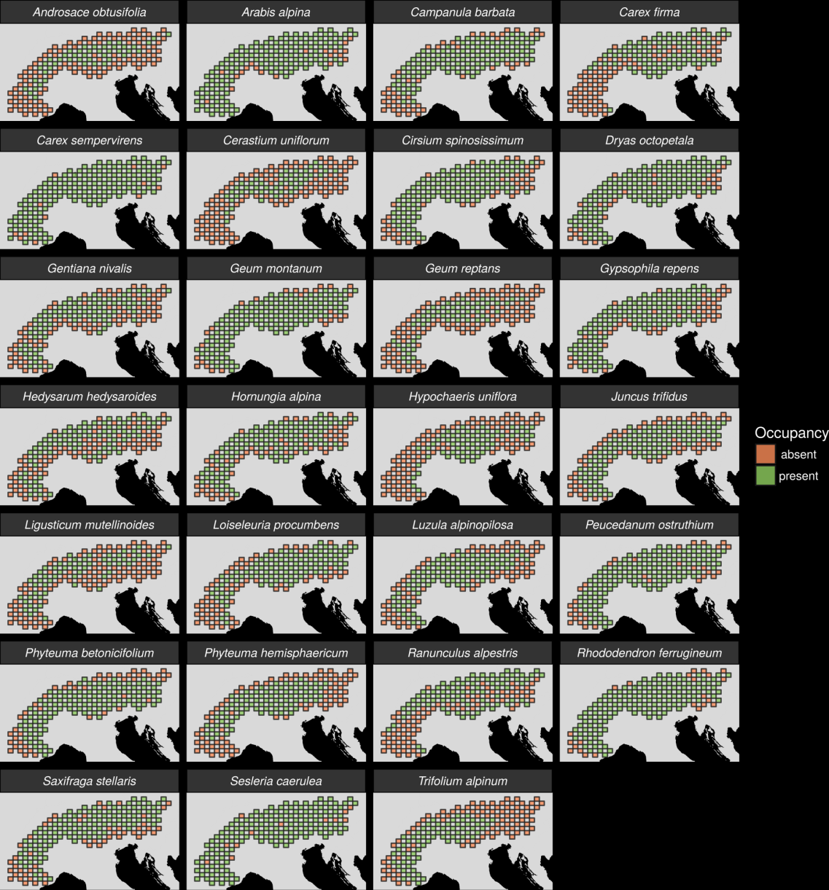
27 plant species
Different dispersal
Different life-histories
Different niches

Slide 40
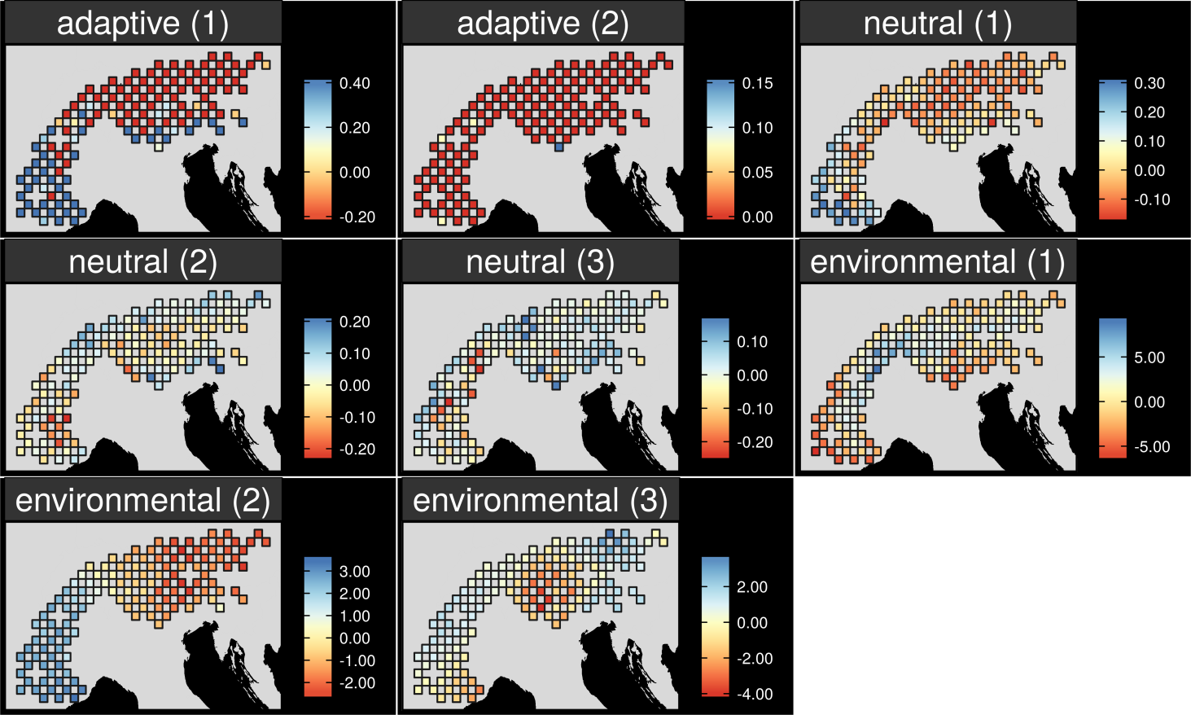
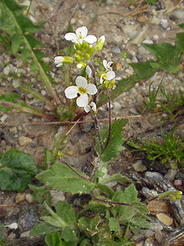
Map intra-specific variation
Arabis alpina

Slide 41
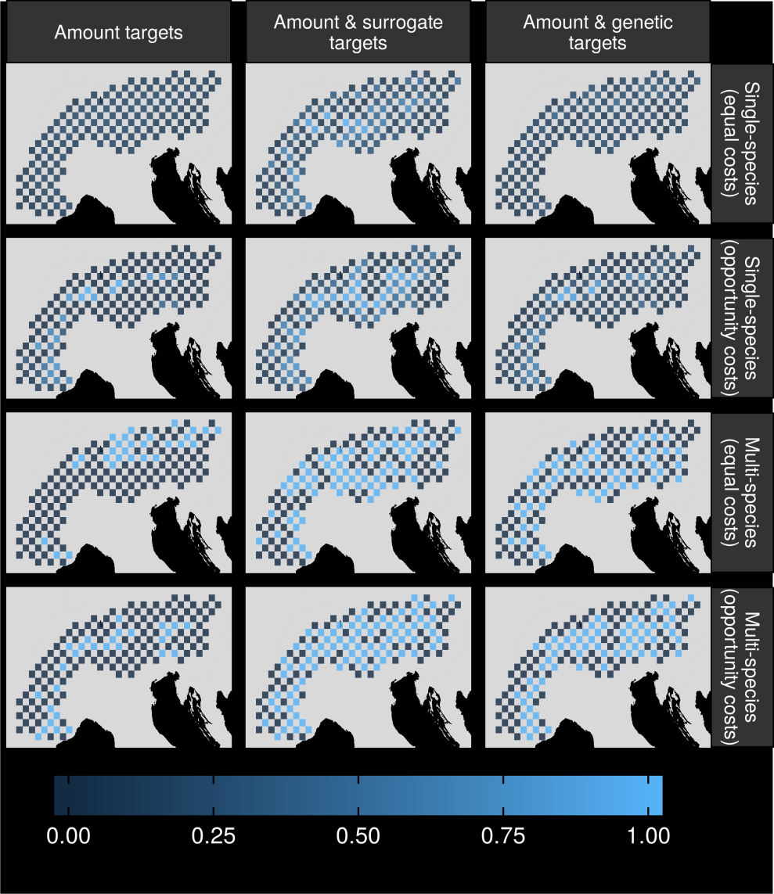
Can surrogates inform our decisions?

Slide 42
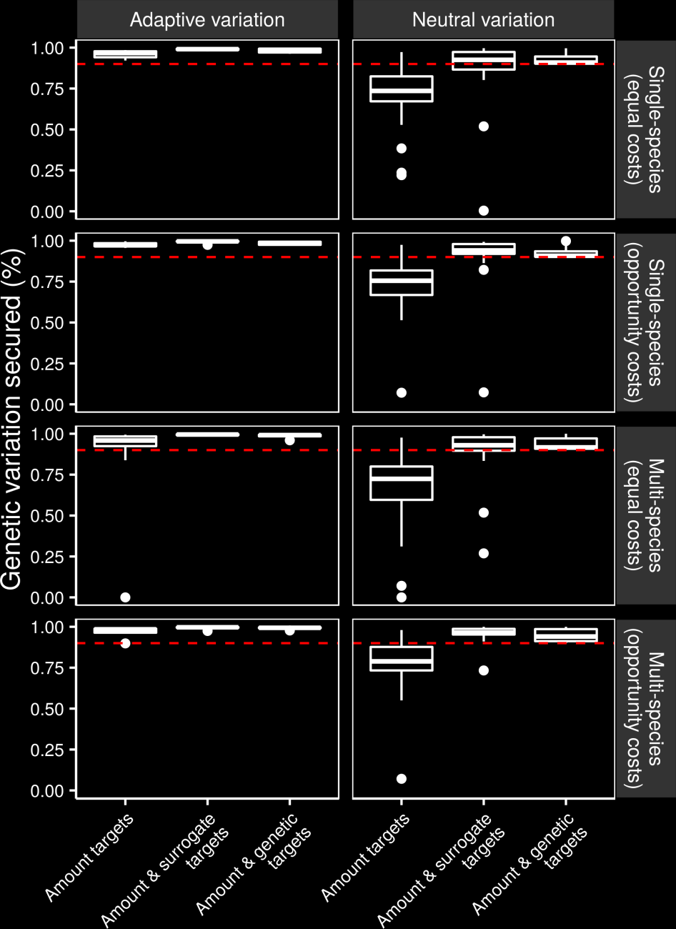
Can we make better decisions using surrogates?

Slide 43
Can we make better decisions using surrogates?

Slide 44
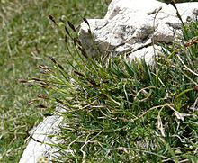
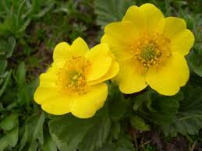
Surrogate performance
Effective for most studied species
Conventional methods may capture adaptive variation
Performance of geographic distances may depend on dispersal mechanisms

Slide 45
Does this generalize to other systems?
Hanson et al. under review

Slide 46
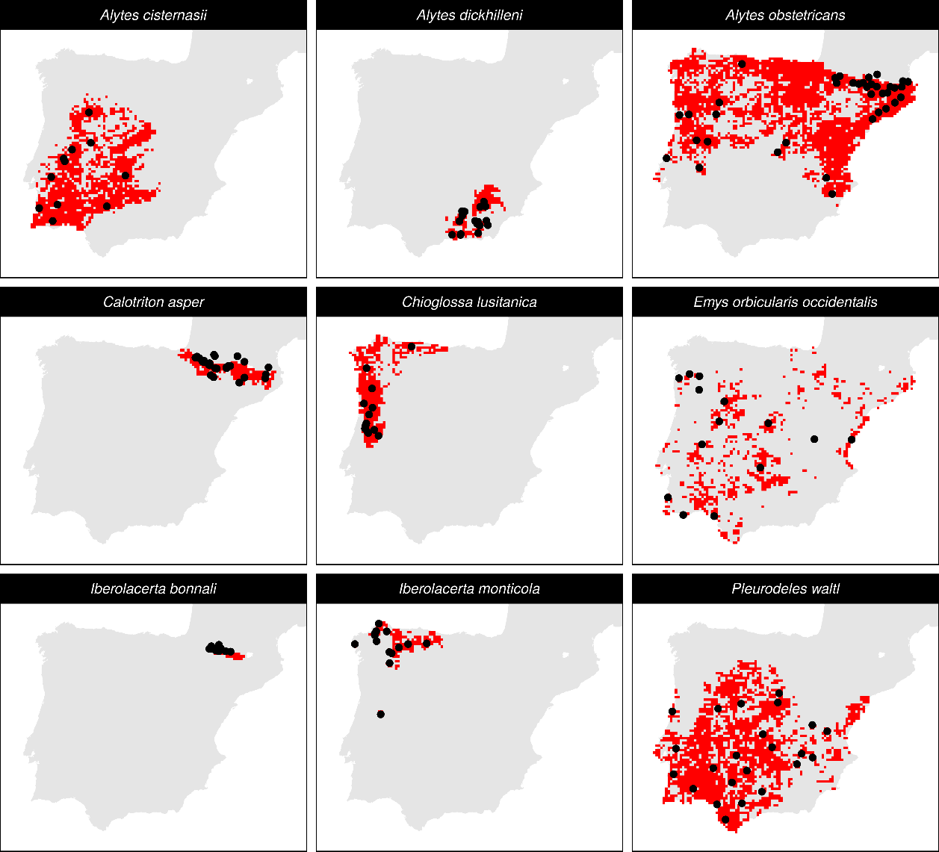
Iberian
Herptofauna
Six amphibians
Three reptiles
Microsatellites

Slide 47
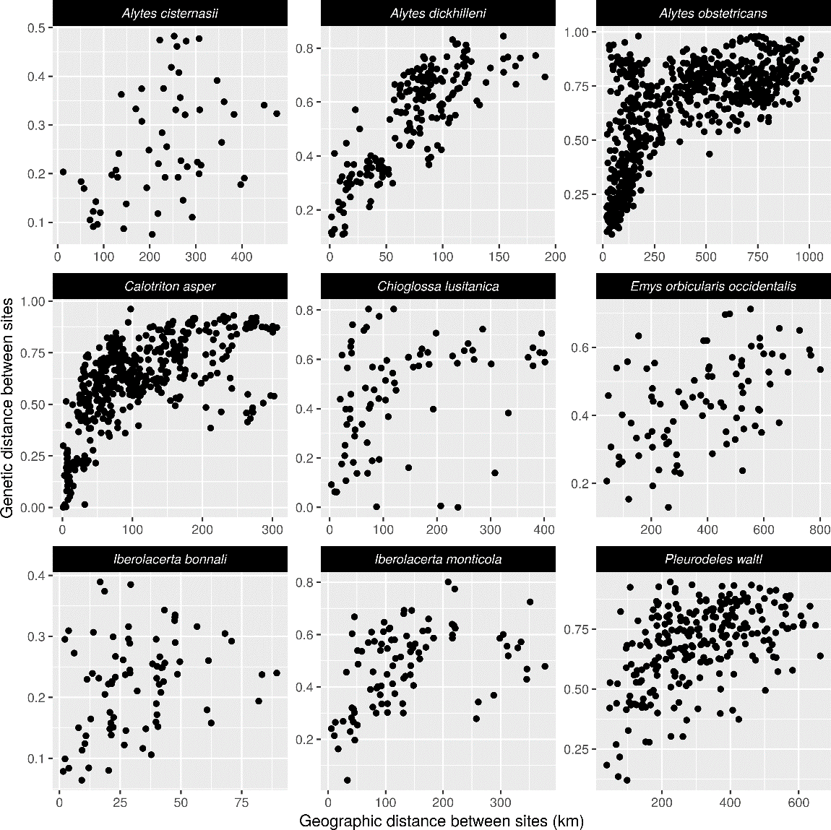

Slide 48
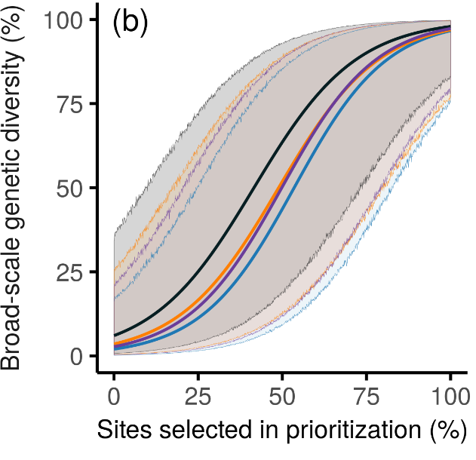

Slide 49
How good are conventional approaches for capturing gene flow and can we do better?
Hanson et al. 2019 J. Appl. Ecol.

Slide 50
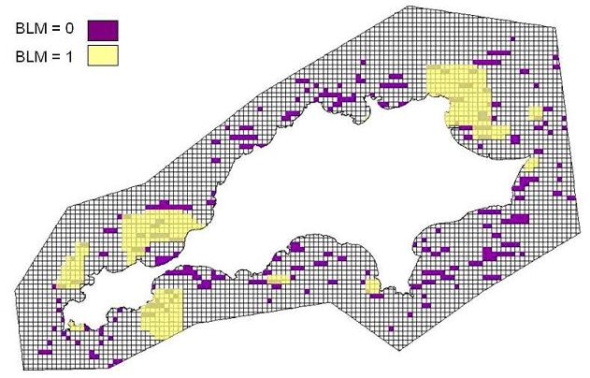
Conventional approaches for connectivity
More clumped -> more connectivity
No species-specific data
No landscape data

Slide 51
Reserve selection using genetic data
Suitable habitat
Dispersible habitat
Solution
Suitable
High connectivity
Selected
Unsuitable
Low connectivity

Slide 52
Reserve selection using surrogate data
Suitable habitat
Suitable habitat
Solution
Suitable
Selected
Unsuitable

Slide 53
Performance evaluation
Genetic-based solution
Surrogate-based solution

Slide 54
Performance evaluation
Genetic-based solution
Dispersible habitat
Surrogate-based solution
Maximum 5 units of
connected habitat
Maximum 2 units of
connected habitat

Slide 55
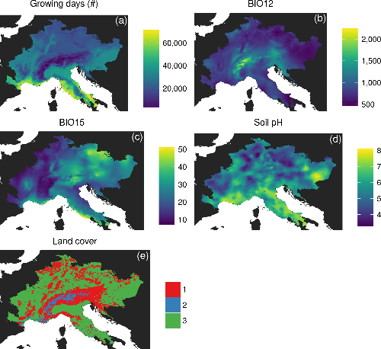
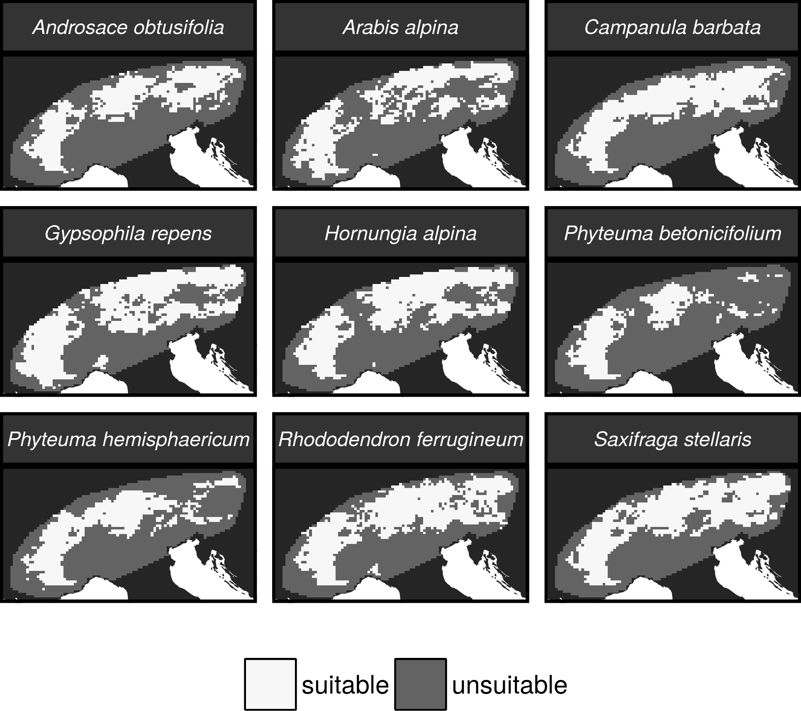
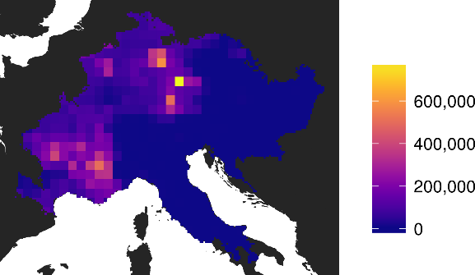
Environmental data
Suitable habitat
Occurrence records
from online database
Suitable
Unsuitable

Slide 56
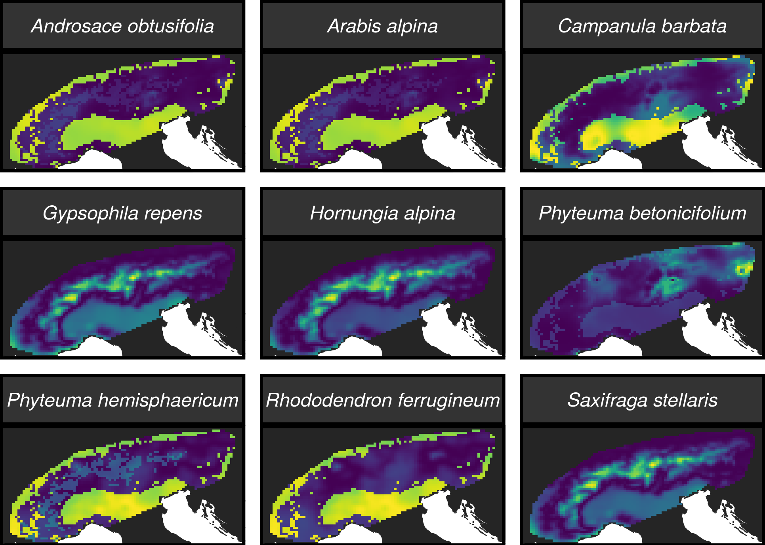
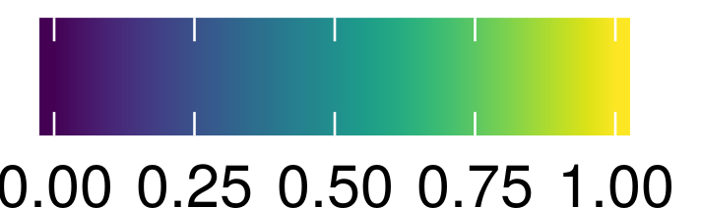
Environmental data
Resistance to gene flow maps
Genetic data

Slide 57
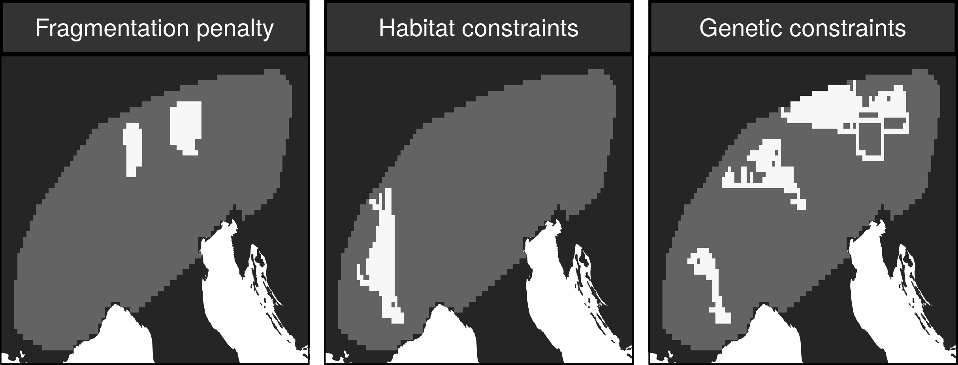
Do we need genetic data to maintain gene flow?

Slide 58
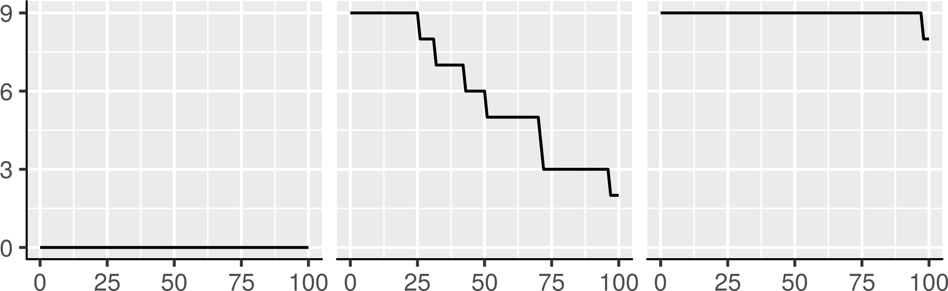
Do we need genetic data to maintain gene flow?
Percent of species with
gene flow maintained
Strength of gene flow required in prioritization
(percentile threshold)

Slide 59
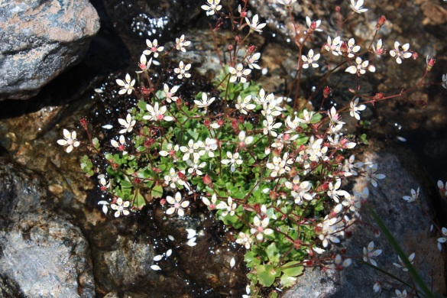
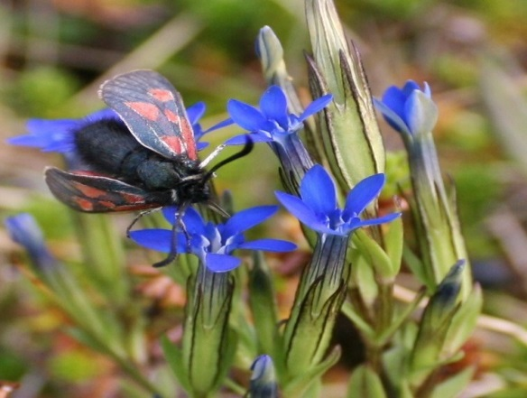
Prioritizations need gene flow data
Genetic data was needed to make prioritizations that could maintain strong levels of gene flow
Potentially complicated by dispersal mechanisms
We can incorporate species-specific connectivity into prioritizations

Slide 60

How well are existing protected areas covering species’ realized niches?
Hanson et al. in press Nature

Slide 61
Evolutionary processes
Species range
Population

Slide 62
Species data
9,670 bird, 5,070 mammal, 5,197 amphibian species
5 × 5 km maps delineating suitable habitat
Subdivide each species’ distribution into 10 “environmental” partitions
Habitat targets set following standard approaches

Slide 63

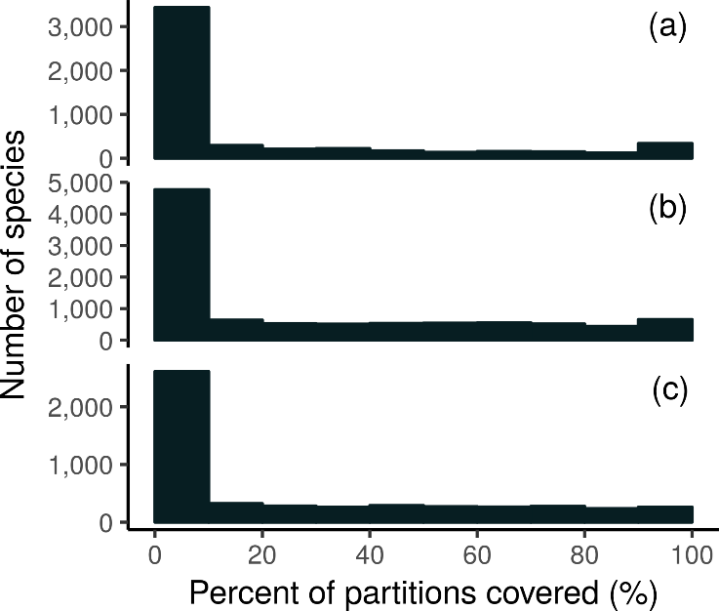
How good is the existing system?
Amphibians
18,688 (94%) species are not adequately represented in reserves
8,921 (45%) species do not have a single partition adequately represented
Of these 8,921 species, 2,266 species are globally imperilled
Birds
Mammals

Slide 64
Giant Panda
Local adaptations
in immune system

Slide 65
Italian Agile Frog

Slide 66
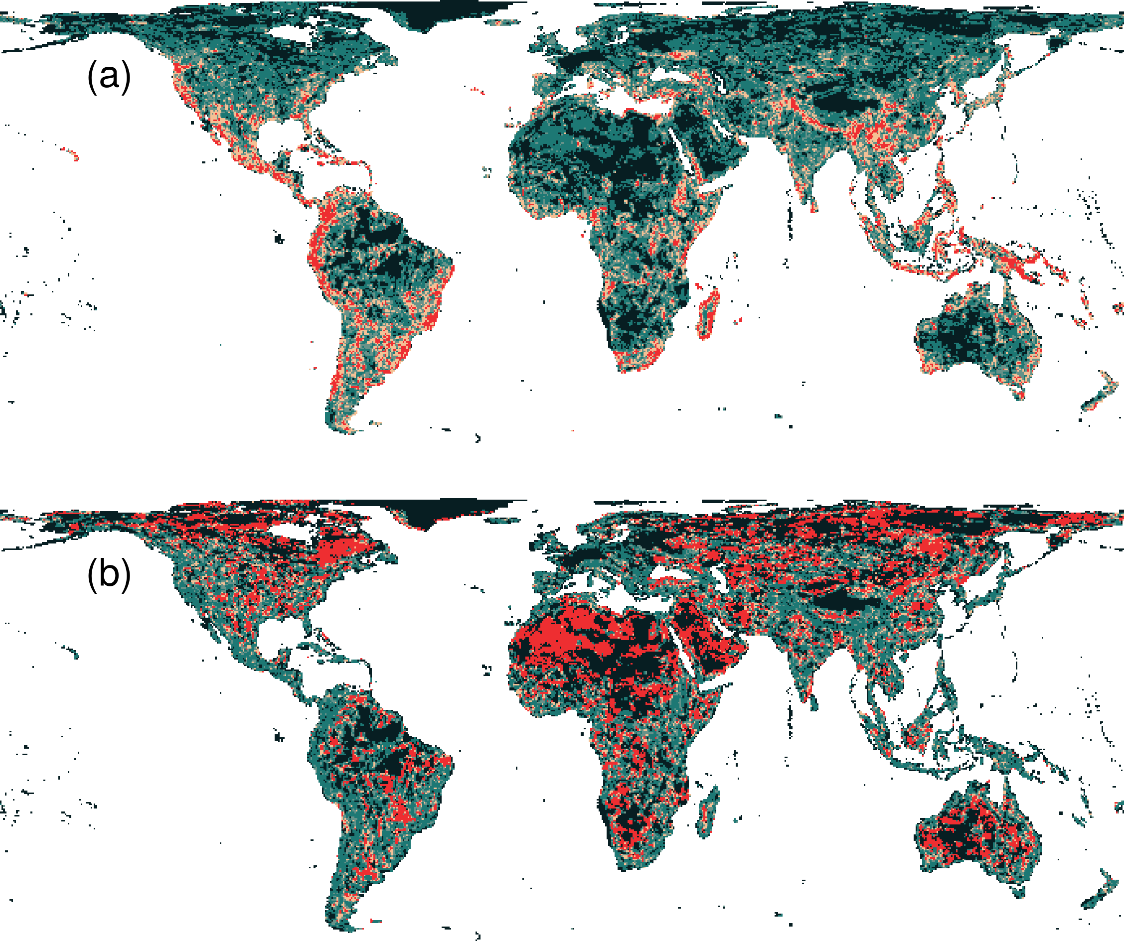
Prioritization for realized niches
35.9 % of the Earth’s land needed to complement existing protected areas
Biodiversity hotspots are critically important
Conservation efforts needed across the planet

Slide 67
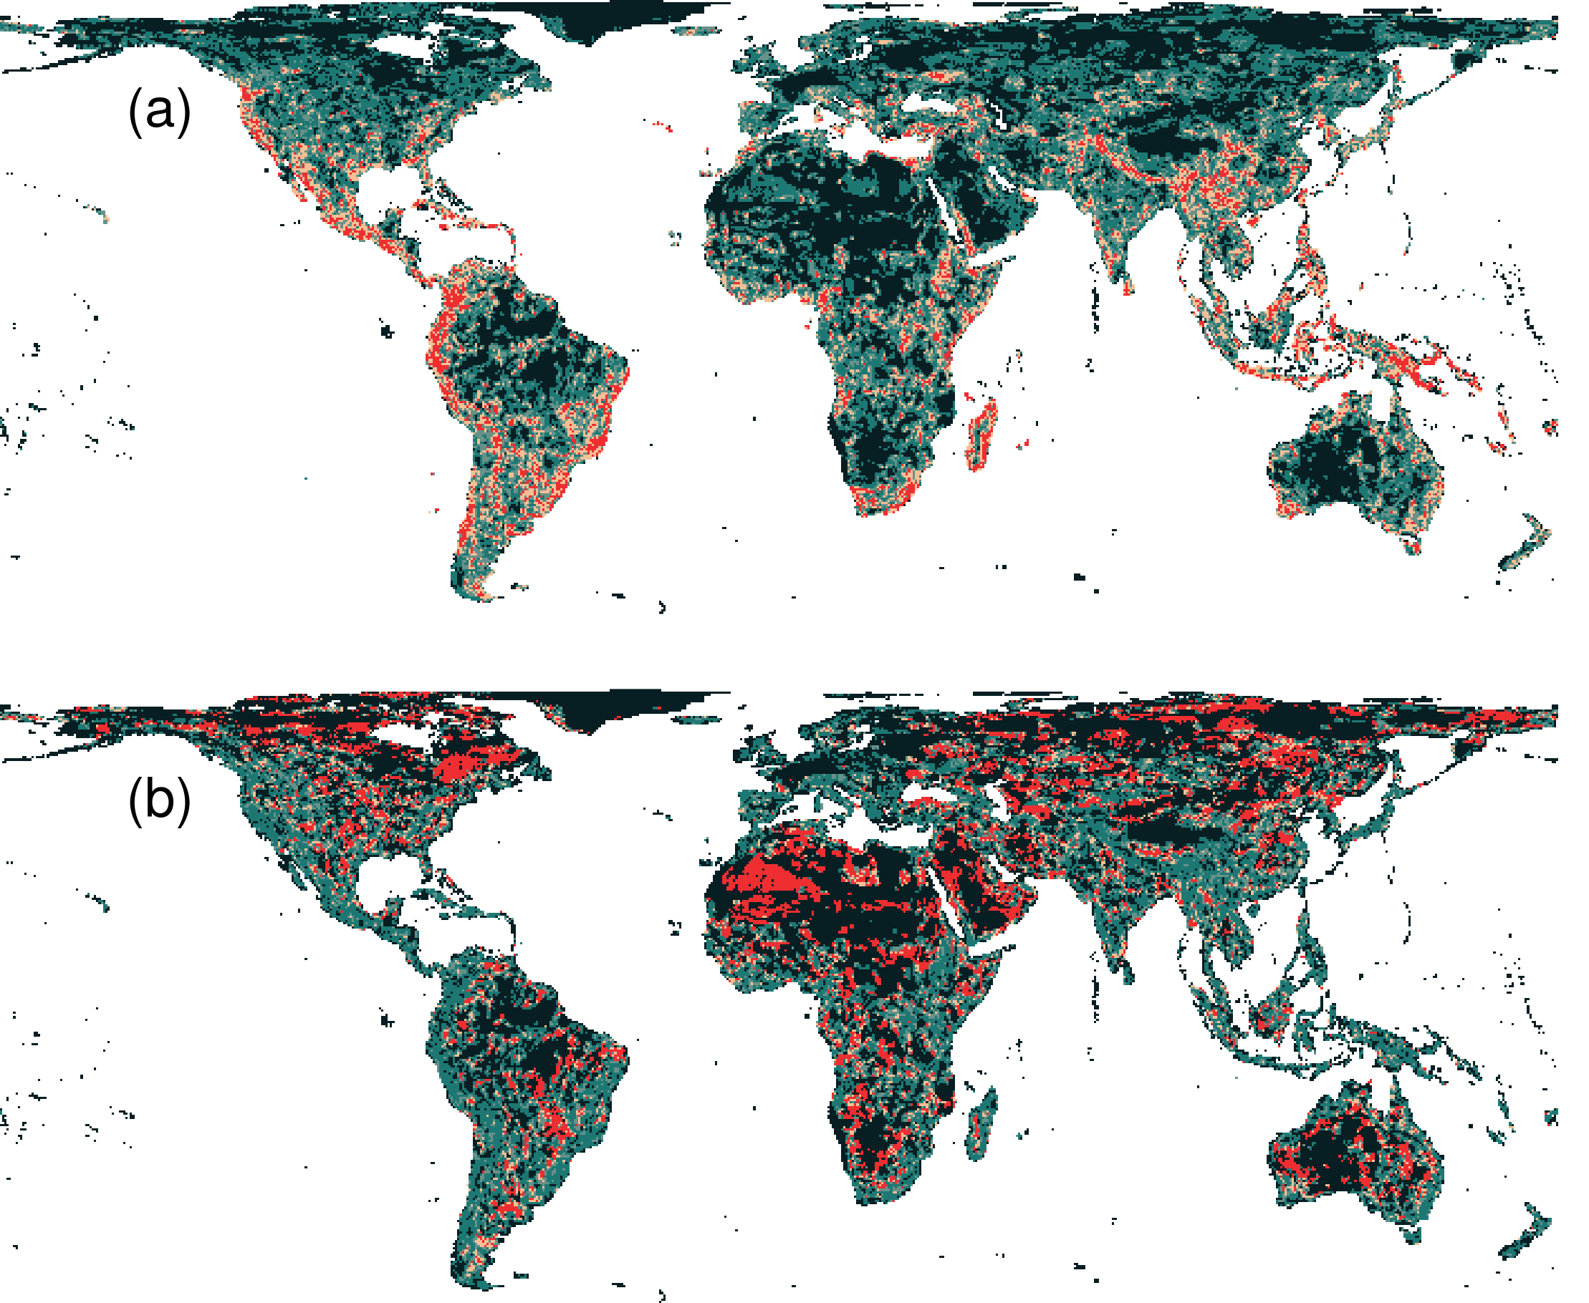
What if we ignore species niches?
Only 3.7% less of the Earth’s land than prioritization which considers niches
Fails to adequately represent 7,989 (40%) species

Slide 68
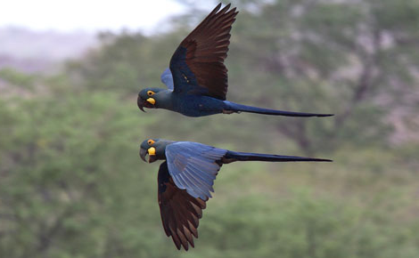
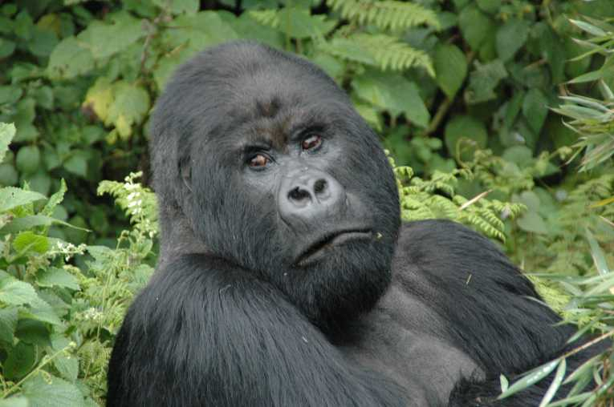
Global conservation of realized niches
Current protected area system is insufficient
More protected areas are needed to fill the gaps
Future conservation efforts need to explicitly account for environmental variation

Slide 69

Apply this to your own work!
raptr R package
Intra-specific variation in prioritizations
prioritizr R package
General purpose spatial prioritizations
oppr R package
Prioritize conservation projects
wdpar R package
Download and clean protected area data

Slide 70
Take home messages
Better algorithms can make a big difference
Better data means more effective decisions
Surrogates may work – no guarantees!

Slide 71



jeffrey.hanson@uqconnect.edu.au
github.com/jeffreyhanson
jeffrey-hanson.com

